Slide 1




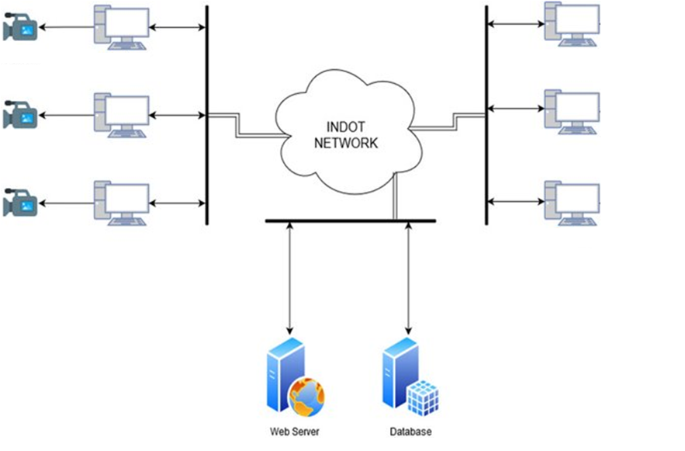
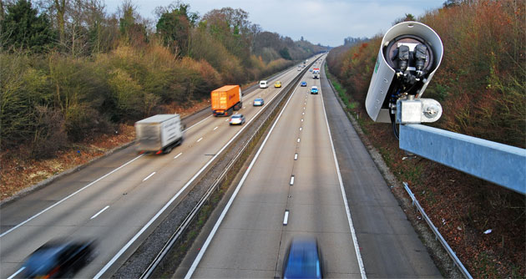
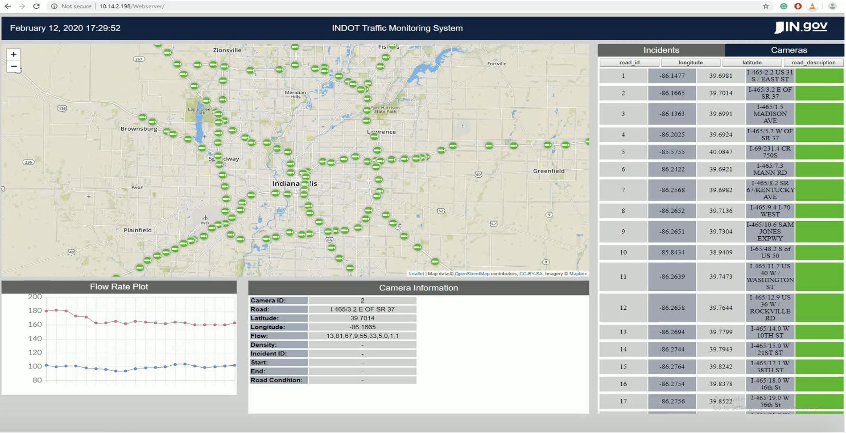
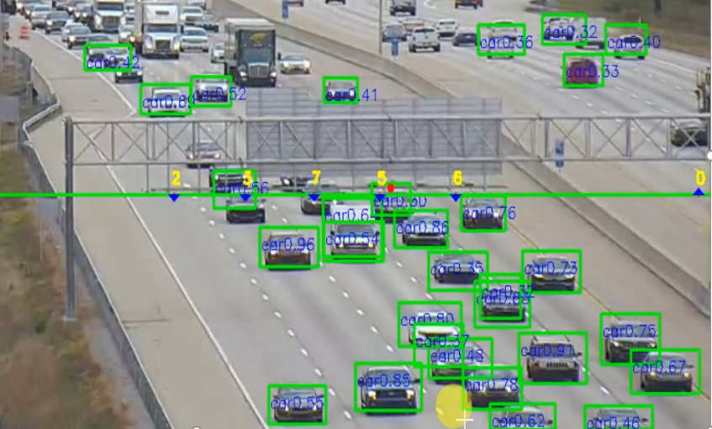
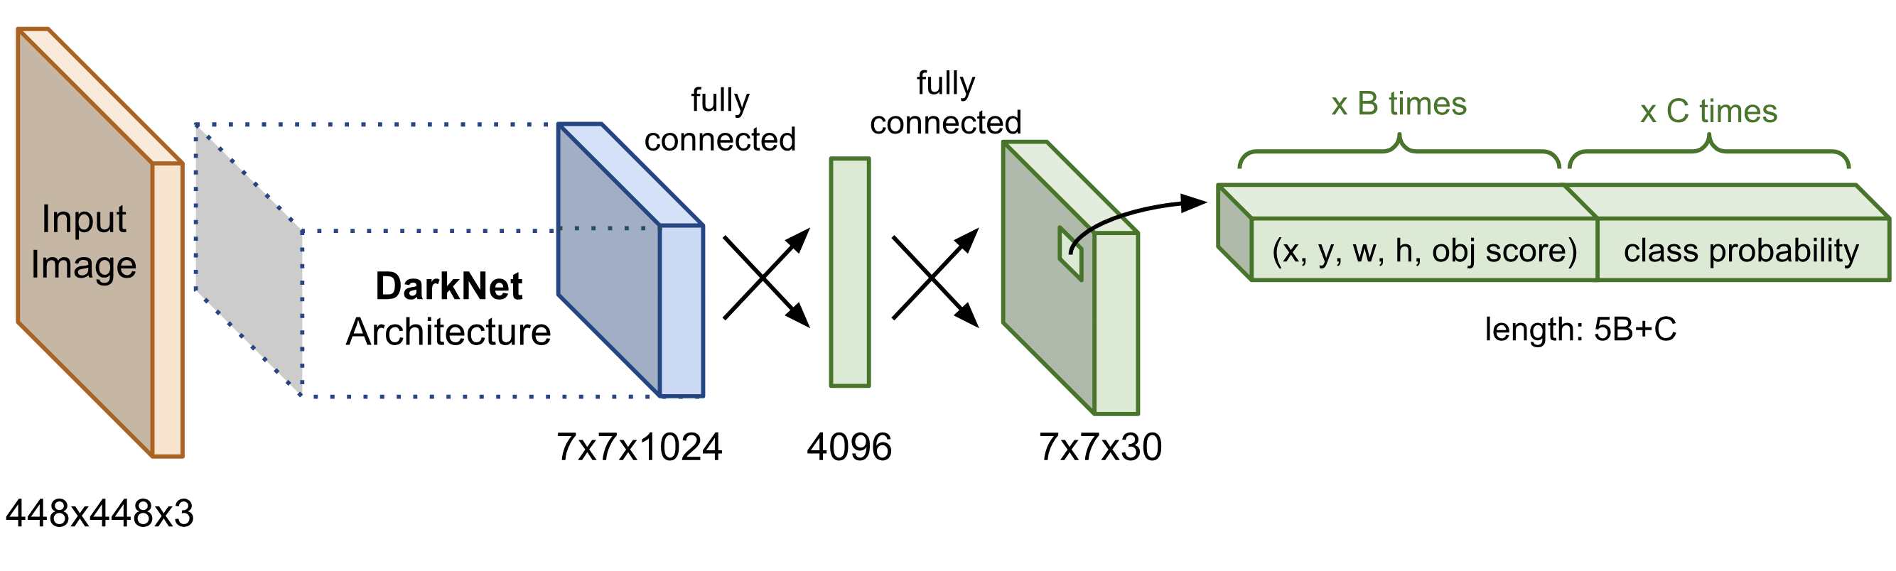
Vehicle and Incident Detection and Classification
from Existing INDOT CCTV Feeds
Contacts: Stanley Chien, Yaobin Chen, Zhengming Ding, TASI, IUPUI, schien@iupui.edu; Jim Sturdevant, TMC, INDOT, jsturdevant@indot.in.gov
Abstract
Proposed Architecture
Remaining Work in Future
INDOT has installed hundreds of cameras on Indiana highways to monitor the traffic conditions. Currently the camera videos are monitored by several INDOT operators. This project is to develop an automated and intelligent traffic condition monitoring system that will (1) automatically detect the traffic density, flow rate on each lane at all locations observed by the cameras, (2) identify the number and type of vehicles passing through each road, (3) detect start and end locations of traffic jams, (4) detect accidents, (5) prioritize the importance of different incidents and notify the traffic monitoring operators for all traffic incidents and (6) provide tools to the traffic monitoring operators to quickly gather the information of the incident scene. Future extension of this project will be to detect hazardous road conditions, such as black ice, snow accumulation by using the same system from this research.
Each camera is connected to a Desktop Computer. Each computer runs a python program for video processing and upload vehicle flow rate and speed in each lane to the database.
Detect starting and ending locations of congestions and incidents
Improve the accuracy of the system
Develop algorithms for unlit roads (Current results only work in normal conditions)
Determine effective ways to clear a traffic jam
Develop methods to predict a traffic jam to prevent it from happening
Responses a traffic accident efficiently.
Field Camera
Field Computer
Office PC
C
Field Camera
Field Computer
Office PC
A
Field Camera
Field Computer
Office PC
The webserver connects to the database to retrieve required data and display it on website that can be accessed from the INDOT network.
The webserver and the database will work when they are on the same network as the cameras are.
Improvement
Improve accuracy of vehicle detection algorithm by using tracking techniques
improve the accuracy of road and lane detection by using known and history information
Introduction
B
INDOT has installed many cameras and radars on Indiana’s highways to monitor traffic conditions
Current Progress
Currently, all these cameras are observed by human operators
Detection Software Structure
Web Page Development
Road Detection
First 1000 frame to get Road
Get Region of interest
Issues to be addressed:
Is there water accumulation on the road?
What is the snow accumulation level on the road?
Is there black ice on the road?
Are there debris on the road?
Get lane center positions and motion directions
Lane Detection
Using AI model (Yolo_v3+Tracking) for Vehicle Detection
Detect the motion of all observed vehicles
Answers to these questions can help INDOT’s road maintenance team, the emergency response team, and driving condition notification team to perform more accurately and efficiently with real-time information. TASI proposes to answer these questions use the following information:
Camera video streaming
weather forecast information
current weather information
road snow plow/deicing history
and Artificial Intelligence algorithms to solve:
Traffic flow rate and speed on each road and lane
Starting point of the traffic jam
Location of incidents
Causes of the traffic jam
The work may also include the control of cameras in a scheduled motion pattern or automatic smart search patterns
Traffic Flow Calculation
Using AI model (Yolo_v3+Tracking) for Vehicle Detection
Detect vehicles
Detect vehicle flowrate of each lane
Detect vehicle speed on each lane
Detect vehicle density on each lane
Incidents Detection
Calculate changes of vehicle flowrate, speed, and density
Start of Traffic Congestions
End of Traffic Congestions
Traffic Jams
Lane and Vehicle Detection
Real-time Upload to Database
System diagnostics
AI model

